Slide 1
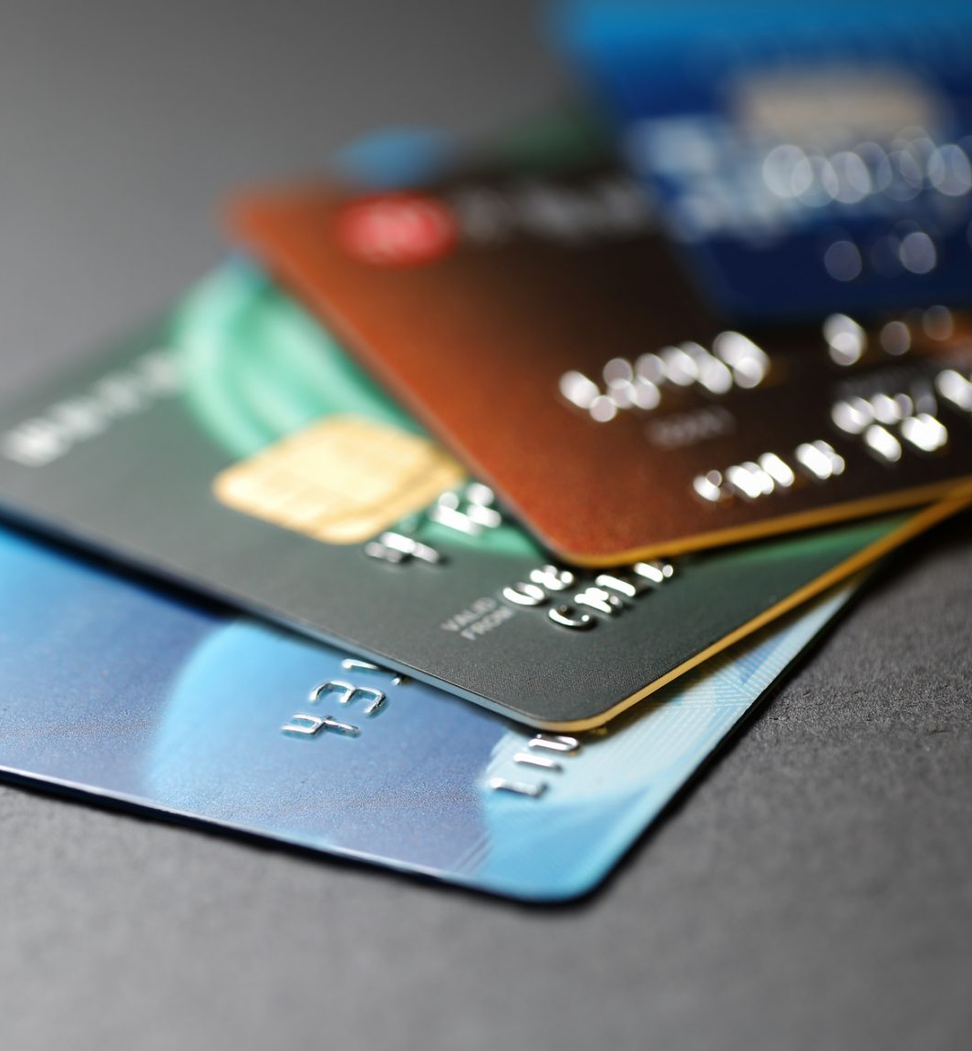
Main sources of chargebacks…
…and what can be done to reduce them.
Piotr Żukiewicz

Slide 2
Current ratio of chargebacks to all successful transactions:
1.47%
Efforts should be taken to reduce it to below 1%

Slide 3
Incorrect amount billed was a reason behind all 318 reported chargebacks.

Slide 4
How many chargebacks has each credit card filed?
205 unique credit cards responsible for 318 chargeback transactions
150 of those cards have only filed one chargeback each
55 credit cards filed multiple chargebacks
Some of them filed as many as six chargebacks

Slide 5
Share of countries in chargebacks and in all successful transactions*
All countries have a similar share in total transactions (~2%)
The same cannot be said about chargebacks, as some of the countries have a significantly larger share of chargebacks than others
Panama, Russia, Turkey and Thailand all have a chargebacks share at least 4 times greater than their share in total transactions
*countries corresponding to customers’ IP addresses; 20 countries with the highest share of chargebacks shown

Slide 6
Share of customers’ countries (%) in all chargebacks reported
Customers from these four countries were responsible for 137 of reported chargebacks, which makes up more than 43% of all chargebacks filed
Panama leads the way with 47 chargebacks, followed by Russia (33)
Customers from the remaining 45 countries have only filed 181 chargebacks in total

Slide 7
Share of customers’ countries (%) in all customers showing suspisious activity*
54 customers that showed suspisious activity were responsible for 166 chargebacks (53% of the total)
38 of these customers were making transactions from either Panama, Russia, Turkey, or Thailand
They were responsible for 121 chargebacks (38% of the total)
*customers that reported more than one chargeback and their number of normal transactions was lower than the number of chargebacks

Slide 8
Bank country vs IP country mismatch
There are 19 customers whose credit cards are registered in a country that does not match their IP address.
All 19 customers are from Panama and have their cards registered in the US.
These 19 customers made 49 successful transactions.
They filed chargebacks in 47 of them (96%).
Coeffcient of correlation between the mismatch of countries and the chargebacks being filed is 0.374, suggesting a possible relationship between these two variables.

Slide 9

Course of action
The following steps should be taken in order to limit the number of chargebacks

Slide 10
Ensure that the amount billed matches the amount the customer is accepting when making a transaction – incorrect amount billed was a reason for all chargebacks filed to date.
Monitor transactions made by customers from Panama, Russia, Turkey and Thailand – reducing their share in total chargebacks to a standard level (~2%) would decrease the total number of chargebacks from 318 to 207 (bringing the ratio of chargebacks to all transactions down to 0.94%).
Monitor suspicious behaviour of customers and gather evidence to refute the claims of known offenders – customers commiting friendly fraud will be far less likely to get their chargeback claims accepted in the future, if there is evidence they had filed a chargeback under false pretences before.
Investigate customers making transactions from Panama that have their cards registered in the United States – it is likely that a significant number of them abuses their rights to chargeback claims.

